Slide 1
Clinical anatomy in relation to local anesthesia

Slide 2
The management of pain in dentistry requires a thorough knowledge of the fifth cranial nerve
Trigeminal nerves provide, the overwhelming majority of sensory innervation from the teeth, and soft tissues of the oral cavity.
Trigeminal nerve is also the largest cranial nerve. It is composed of a small motor and considerably larger sensory root.
The motor root supplies the muscles of mastication and other muscles in the region.
The three branches of the sensory root supply the skin of the entire face and the mucous membrane of the cranial viscera and oral cavity, except for the pharynx and the base of the tongue

Slide 3
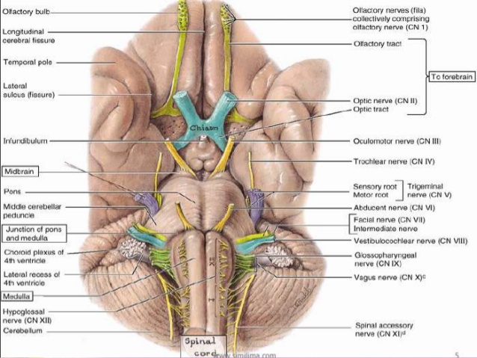

Slide 4
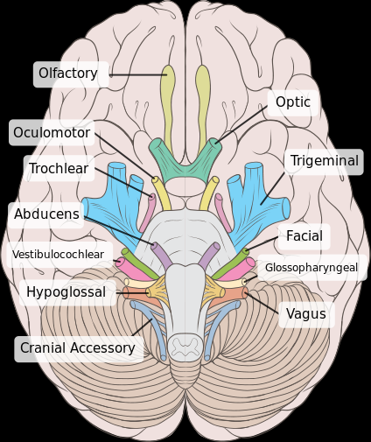

Slide 6
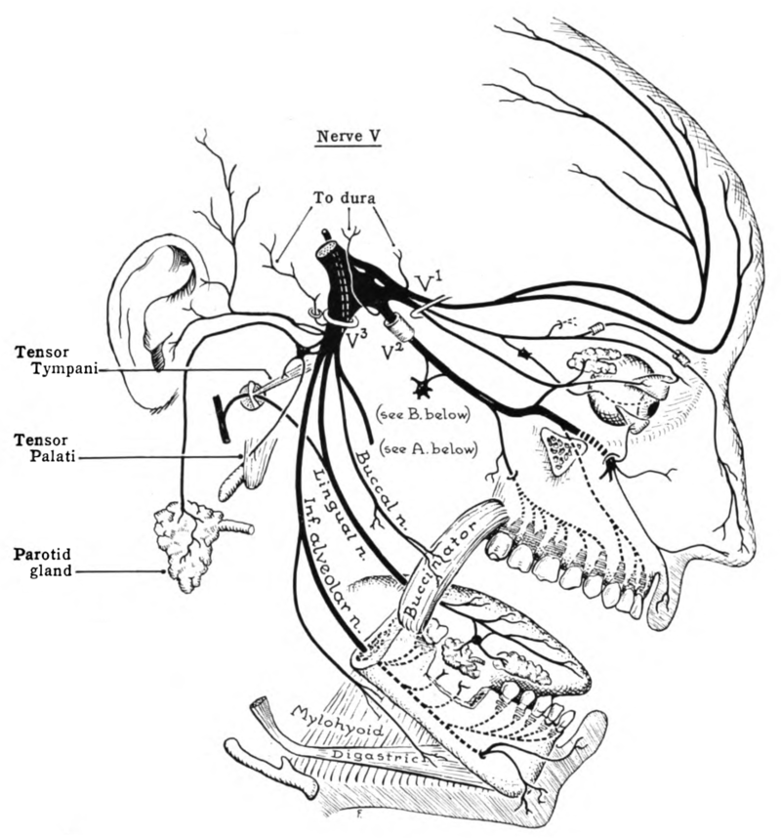

Slide 9
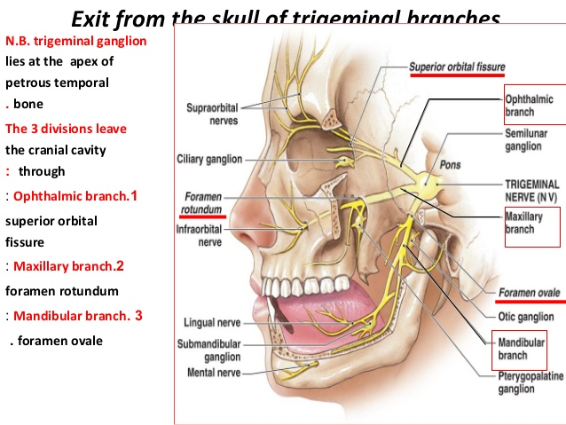

Slide 10
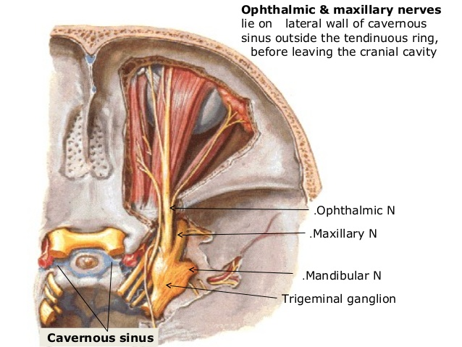

Slide 17
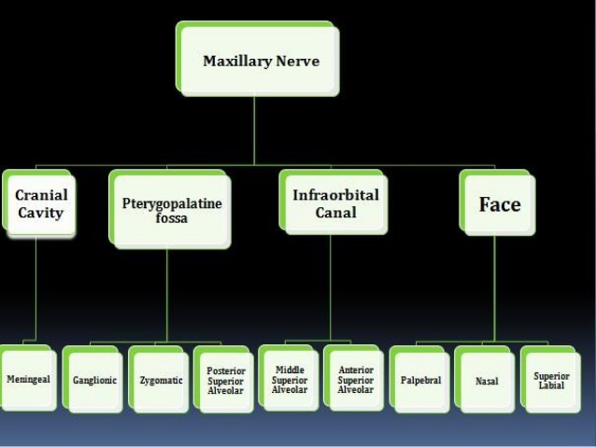

Slide 19
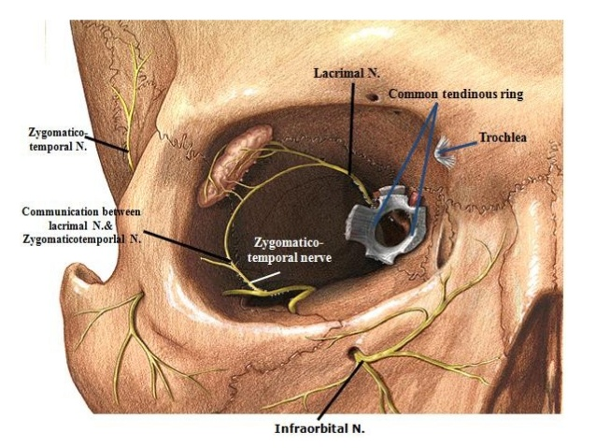

Slide 20
Branches from the ganglia include:
Orbital nerve: supplies the periosteum of the orbit.
Posterior superior nasal nerves: supply the mucous membranes of the lateral wall of the nasal cavity, and portion of the nasal septum.
Nasopalatine nerve: Runs from the pterygopalatine ganglia into the nasal cavity through the sphenopalatine foramen.. The right and left Nasopalatine nerves emerge together through this foramen and provide sensation to the palatal mucosa in the region of the premaxilla (canines through central incisors).

Slide 21
5-Greater palatine nerve: it descends through the greater palatine canal, emerging on the hard palate through the greater palatine foramen (which is located about 1 cm toward the palatal midline, just distal to the second molar).
5. Lesser palatine nerve: provides sensory innervation to the soft palate.
6. Pharyngeal branch: supplies the mucosa of the nasopharynx.

Slide 22
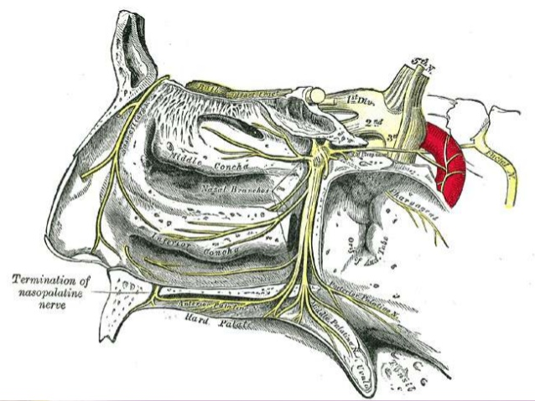

Slide 29
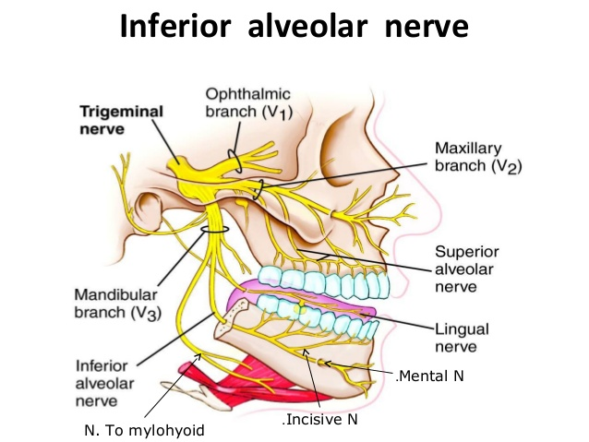

Slide 31
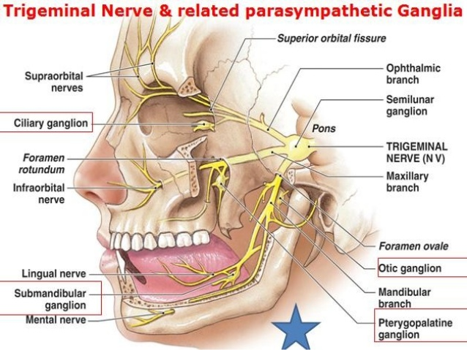

Slide 32
THANQ

